Slide 1
Test Document #1

Slide 2
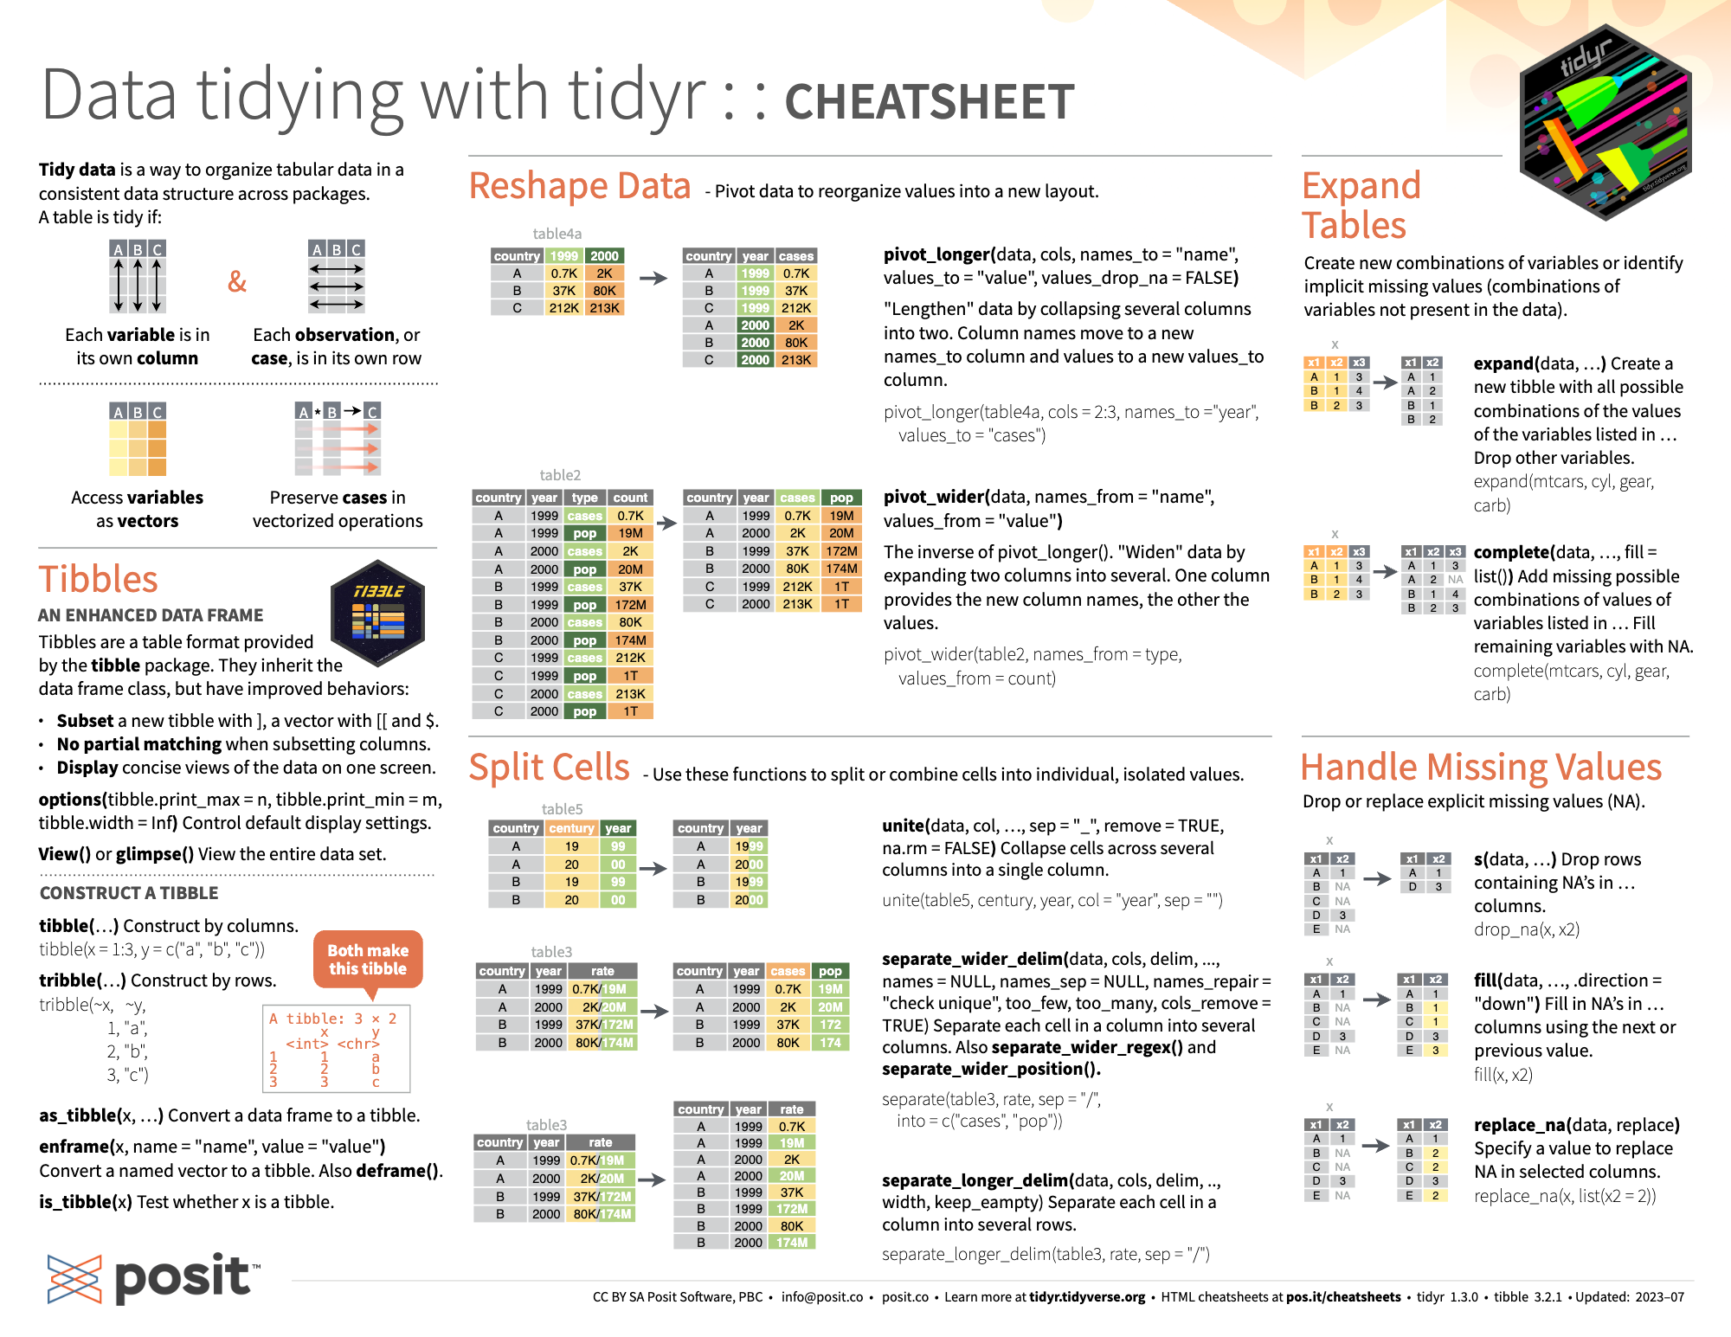
Introduction
Is it possible to answer every question we pose?
What is experimental design?
When should we start to plan how we are going to analyze our data?
lm <- rep(1,4,8)
TidyR Cheatsheet

